Slide 1
Business Central on Docker

Slide 2

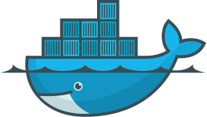
Overview
Running containerized apps with Docker
What is Docker?
Docker Terms & Functions
Running Business Central in a Container
Docker Use Cases

Slide 3

Mostly an introduction to Docker
with Business Central
Notes:
Slides can be used as a reference work. It will be uploaded alongside som example scripts to get started.
Will skip through some sections rather quickly because you can try them with the Masterclass files or it won’t be used much with BC.

Slide 4
What I don’t yet know
How to build a custom Business Central image
How to deploy Business Central as a production environment
Container Orchestration (e.g. Kubernetes, Docker Swarm, Docker Compose)
How to implement custom configurations to an image
How to include custom extensions in an image
How to implement AAD-authentication
How to setup secure connections (SSL/TLS certificates)
How to deploy automated testing
In-depth details about underlying technologies and functions
How to use environment variables
How Docker can improve CI/CD pipelines
How containers are different from VMs at a technical level
How to integrate BC containers with other Dynamics 365 apps, e.g. for Sales
How the Docker Daemon (dockerd) works
How to run Docker containers in Azure
How to set up a Git-project on Azure DevOps Services
How to set up source code providers for source code management
How to manage version control of Docker images
How to use GUI tools for containers such as Kitematic
How Docker Machine works
A LOT!
Notes:
We will potentially use Docker quite a lot in our daily activities.
Use cases are presented later but are not exhaustive.
It is an open project and a topic to be explored further.

Slide 5
1.
What is Docker?

Slide 6
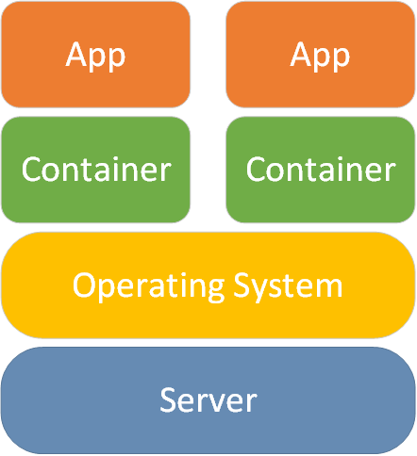
What is Docker?
Software that allows you to run containerized applications.
Docker is mostly useful for DevOps, but can also be useful for development in isolation.

Slide 7
What is Docker?
Easy to get started
You will be able to run a Business Central container within half an hour without any prior knowledge of Docker if you know where to look.
Comprehensive topic
Docker sometimes underlies entire DevOps pipelines, and you will need to know a lot to optimize the processes.

Slide 8

Advantages of Docker – DevOps Benefits
Productivity in CI/CD pipeline
Parity (Standardized/repeatable environments)
Avoid dependency issues
Rapid deployment and rollbacks
Isolation
Apps only use assigned resources
Security (shared host vulnerability)
Removing a container removes all temporary or configuration files
Portability/ Scalability
Works almost everywhere
Setup dev env on new computer
Add new containers as needed
Multi-Cloud Platforms
Deployment across national borders

Slide 9
Advantages of Docker – Business Benefits
Increased ROI
Higher returns on IT investments due to efficient DevOps (productivity increases and reduced infrastructure costs)
More value-adding activities
By increasing time for feature development
Reliable and secure applications
Supporting other organizational processes

Slide 10
Isolation
Isolated from apps on host computer unless configured otherwise.
 | Hyper-V | Process
OS Kernel | Isolated and included in each container | Shared with host
Advantages | Secure Run BC containers on older Windows versions | Lightweight Well-suited for running multiple service tiers (roughly equal to running it on host)
Disadvantages | Demands more memory | Less secure in multi-tenant environments Image must match host OS
Notes:
Relatively isolated (e.g. from other apps on the host computer unless configured to do so)
Less isolated than virtual machines

Slide 11
Isolation for Netcompany Computers
Netcompany laptops are currently running Windows in version 1803 and can thus only run Hyper-V isolation. We will get 1903 within two months according to IT Services.
However, you can create a VM that runs 1809 in the Hyper-V Manager and assign it minimum 4 GB memory. Beware, that you also need the dynamic memory to be 4GB at minimum.
Note also, that you need to use the ‘-updateHosts’ flag when creating a container.

Slide 12

Prerequisites for Using Docker (with BC)
Windows Server 2016 or 2019 or Windows 10
Activate Windows Features
Containers
Hyper-V (optional on 1809 or later)
Docker account
Docker Desktop installed (switch to Windows containers)
Recommended: NavContainerHelper

Slide 13
2.
Docker Terms & Functions

Slide 14
Docker Terms & Functions
Image = template
Container = instance

Slide 15
Docker Image
“An image is an executable package that includes everything needed to run an application--the code, a runtime, libraries, environment variables, and configuration files.” – from Docker Documentation
Comprised of multiple (reusable) layers. Container layer is writable – the rest are read-only.
Notes:
A containerized/dockerized app is created by building a Docker Image
Set of files and a block of configuration used by Docker
Can be run on desktop, on server or in the cloud

Slide 16
Docker Image
Either Linux or Windows, but images are always separate
Linux → only Linux images
Windows → both
(Windows images directly, Linux images via a virtual machine Linux environment)

Slide 17
Docker Container
Instance of a Docker image
There can be multiple instances at once (e.g. useful with a load balancer)
Connect to it via an exposed port
Network requests are not allowed per default

Slide 18
Docker Container
Each container has a unique ID and name
Changes made in a container are specific to the instance and will be lost when the container is removed
Multiple containers on the same image do not share files (unless configured to do so)

Slide 19
Running a Docker Image
In order to create a new container, you must specify
Registry
Repository
Version tag

Slide 20
Running a Docker Image
Registry
Repository
Tag
mcr.microsoft.com/
businesscentral/sandbox
:dk

Slide 21
Running a Docker Image
Registry
Repository
Version
mcr.microsoft.com/
businesscentral/sandbox
:dk

Slide 22
Docker Registry
A service that stores Docker images and a collection of repositories
Registries are web services to which Docker can connect and upload/download container images
Example: Docker Hub (public & default)
Think Github for Docker repositories

Slide 23
Running a Docker Image
Registry
Repository
Version
mcr.microsoft.com/
businesscentral/sandbox
:dk

Slide 24
Docker Repository
Repository contains multiple Docker images with a common name, but different versions
Unit of privacy → can be made private/public/grant access

Slide 25
Running a Docker Image
Registry
Repository
Version
mcr.microsoft.com/
businesscentral/sandbox
:dk

Slide 26
Docker Image Version
Version tags are text labels.
They can be anything, e.g. ‘v1.0’.
If undefined, ‘latest’ will be pulled

Slide 27
Volume
Volume
Represents a file system that can be mounted by a container
Is made available to applications running in a container
Data in a volume persists when the container stops
Best practice: avoid changes to image filesystem
Notes:
We will use volumes later to add custom scripts and other files to our Business Central container.

Slide 28
Bind mounts
Bind mounts approximate volumes, but are not copied into the container, but rather made available on the host machine.
Performant, but depend on directory structure on host machine. Use volumes in most cases.
Learn more here and here.

Slide 29
Dockerfile
Build instructions
Plain text file containing commands needed to build an image.

Slide 30
Docker Functions – Download and Run
docker pull <image>
Retrieve an image (to local computer)
docker run <image>
Start a container (will automatically pull if necessary)

Slide 31
Customizing a Docker Image
Base images
Save changes to a new image with ‘docker commit’-command
Build an image by running a Dockerfile with ‘docker build’-command
Notes:
Note that we may want to use ‘docker commit’ to create custom images, e.g. preloaded with certain functionality.

Slide 32
From app development to deployed container
Docker Container
Dockerfile + app
Docker Image
docker run <image>
docker build –t <name:tag>

Slide 33
Docker Functions – Stop and Start
docker stop <container>
Stop a container
docker start <container>
Restart a stopped container

Slide 34
Docker Functions – List and Remove Containers
docker container ls OR docker ps
View active containers (-a flag for all)
docker rm <container> OR docker container rm <container>
Remove a stopped container (-f flag for running containers)

Slide 35
Docker Functions – Remove Images
docker images
List local images
docker image rm <image> or docker rmi <image>
Remove an image after removal of containers
docker image prune -a
Remove unused images

Slide 36
Docker Functions – Container Information
docker inspect <container/image>
Information about the container or image
docker logs <container>
Log for your container

Slide 37
Docker Functions – Environment Variables
Environment variables are used to transfer parameters to the container.
These can be used inside the container.
Example: ‘docker run –e accept_eula=Y’

Slide 38
Docker Functions
See documentation here
Or use commands in a CLI:
‘docker’
(for overview of commands)
‘docker <command> --help’
(for specific command information)

Slide 39
3.
Running Business Central in a Container
How to run Business Central as a Docker container

Slide 40
Business Central Docker Images
Microsoft has made two Docker images for Business Central
Sandbox (cloud)
On Premise
There is also a NAV image.
Notes:
Links are repository URLs

Slide 41
Where to Find Business Central Images
Microsoft Container Registry
mcr.microsoft.com/businesscentral/onprem
mcr.microsoft.com/businesscentral/sandbox
GitHub Repo
Build your own Docker image (not currently available - see Misc.)
Insider Builds (mostly for app-developers)
bcinsider.azurecr.io
Docker Hub images are no longer supported

Slide 42
Business Central Docker Images
You can find available versions of BC, BCOP, NAV here:
List of Available BC Sandbox Versions
List of Available BC On-Premises Versions
Script included to find NAV versions in Masterclass files

Slide 43
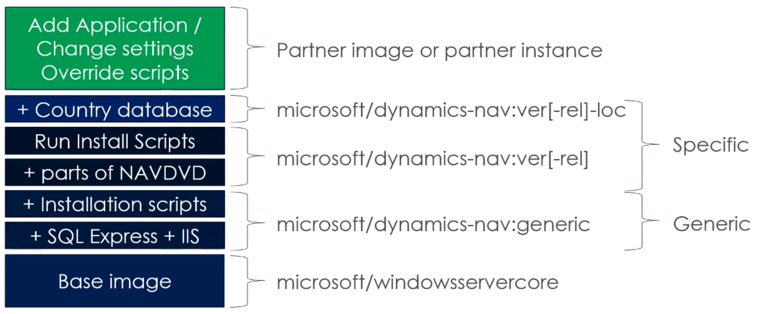
Business Central Image Structure
Layers differ depending on the image version, you choose.
Learn more here.

Slide 44
Where to Find Business Central Images
Business Central containers can be run either:
Locally
On Azure
The focus of this Masterclass is how to do it locally.

Slide 45
You could do everything manually in Docker, but…
NavContainerHelper

Slide 46
NavContainerHelper
PowerShell module to manage NAV containers.
Must be run as administrator.
PowerShell:
‘install-module navcontainerhelper –force’
‘Write-NavContainerHelperWelcomeText ‘
‘help <cmdlet> –Detailed’
Github Repo
Notes:
Help-function is particularly useful since documentation for NavContainerHelper is sparse.

Slide 47
NavContainerHelper
New-NavContainer OR New-BCContainer
Stop-NavContainer
Remove-NavContainer
Start-NavContainer
There are tons of useful cmdlets that you can see in the PowerShell ISE Commands-pane.

Slide 48
NavContainerHelper
Containers path
C:\ProgramData\Docker\containers
C:\ProgramData\Docker\windowsfilter
Standard NavContainerHelper volume
C:\ProgramData\NavContainerHelper\Extensions\<container>\my
Images (layers) path
C:\ProgramData\Docker\image\windowsfilter

Slide 49
Overriding Scripts
How it works:
C:\run = default folder in container
C:\run\my = customized folder in container
‘Copied’ from shared folder
Priority
If C:\run\my exists, use that.
Otherwise, use C:\run\

Slide 50
Using
NavContainerHelper

Slide 51
Authentication
Windows Authentication (default)
Does not work with AD
Azure Active Directory can be implemented
NavUserPassword
Apply $credential variable to –Credential parameter (encrypted via NavContainerHelper)
Example-script in Masterclass-files.

Slide 52
License
Connect to a database that contains a license file
Specify URL or path
Add flag ‘–licensefile’ to New-Navcontainer with the specified path or URL.
Note: Overwrites the database license file.
Override SetupLicense.ps1
Import to running container
Import-NavContainerLicense -containerName <container> -licenseFile <path>
See more here and in the Masterclass example-script.

Slide 53
Managing Users, User Groups & Permissions
Premium plan (for default SUPER user)
Add flag ‘-assignPremiumPlan’ to New-Navcontainer
Setup test users (predefined user groups and permission sets)
Setup-NavContainerTestUsers containerName <container> -tenant default -password $securePassword
Note: Occupies Codeunit 50000 but can be modified if the object already exists.
Users can be added manually by modifying SetupNavUsers.ps1 or the codeunit mentioned.
See more here.

Slide 54
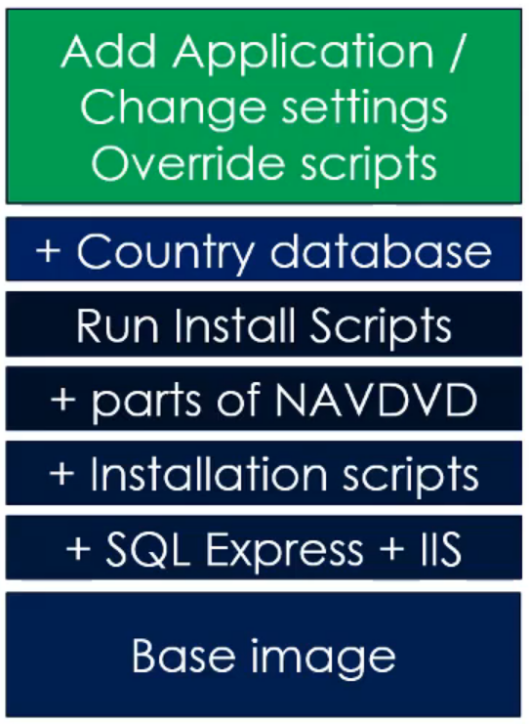
Overriding Scripts
You can override scripts when you create a new container with the –myScripts parameter.
Invoke default behavior:
(Join-Path $runPath $MyInvocation.MyCommand.Name)

Slide 55
Overriding Scripts
List of scripts to override
Find specific script-files in the GitHub repo
Useful as a reference work if you want to do specific things with your Docker container.

Slide 56

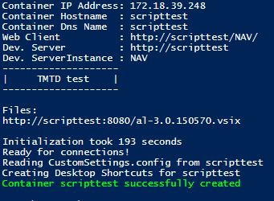
Overriding Scripts
Simple example
New-NavContainer -accept_eula `
-containerName scripttest `
-imageName mcr.microsoft.com/businesscentral/sandbox:dk `
-myScripts @("C:\temp\navscripts\AdditionalOutput.ps1")
AdditionalOutput.ps1 Result:

Slide 57
Share DB with Host Computer
You can share the db-files of the container with the host computer. This allows you to backup database-files when the container is stopped.
This is done by editing SetupDatabase.ps1.
See more details in Masterclass example-script and here.

Slide 58
Mounting a DB from Host Computer
Need either .mdf- and .ldf-files, which can be extracted from an image or a stopped container (e.g. sharing db-files as mentioned).
Or restore a database from a .bak-file.
See more details here.

Slide 59
Editing Code in a Container - AL
You need:
AL Extension for Visual Studio Code
Server (from container)
Server Instance (from container)
To download symbols
Server, Server Instance, and AL Extension-files are printed when you start a new container or with ‘docker logs <container>’.

Slide 60
Editing Code in a Container - AL
Open Visual Studio Code.
You can install the AL Extension from the .vsix included in your container – see your container log as described. Or use the latest version in the Extensions area.

Slide 61
Editing Code in a Container - AL
Start a new project by opening Command Palette (Ctrl + Shift + P) and choosing the command ‘AL: Go!’
In the next prompt, choose ‘Your own server’. Note, the cloud server option can be used for online demos.

Slide 62
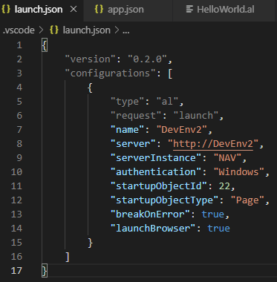
Editing Code in a Container - AL
Server, Server Instance, and Authentication are set in the launch.json file in Visual Studio Code.
See more here.

Slide 63
Editing Code in a Container - AL
After editing launch.json to your environment, you need to download symbols.
Go to Visual Studio Code
Open Command Palette (Ctrl + Shift P)
Use command: ‘AL: Download symbols’
You should now have two packages included in your project. Learn more here.

Slide 64
Editing Code in a Container - AL
A sample ‘Hello World’ extension is included when you start a new project.
If you compile your project and trigger the extension by opening the Customer List page, you should see a message.

Slide 65
Edit C/AL Code
To include Dynamics NAV Development Environment and the Windows client use the flag:
-includeCSide
In the New-NavContainer cmdlet

Slide 66
Import Extensions to container
Edit launch.json to point at the container.
Publish the extension.

Slide 67
Source Code Management
Simply pull a Git Repo and edit the launch.json file to point at your container.
Then compile, edit, test, commit, push, and whatever you may want to do.
An efficient DevOps pipeline with source code management is a topic for further exploration. Perhaps integrated with Azure DevOps.

Slide 68
Troubleshooting
Many things can go wrong.
Here is a good starting point.
It lists a range of common issues, you might face.

Slide 69
Troubleshooting
If you shut down your computer while a container is running, you may have trouble using the container again.
You can usually fix this by editing the container’s config.v2.json-file.
The path is: C:\ProgramData\Docker\containers/<container>/config.v2.json
Usually, you should change running to false and restart the container. You may need to change other settings as well.

Slide 70
4.
Docker Use Cases
For Business Central and NAV

Slide 71
Conversion to AL

Slide 72
Conversion
Before getting started, clean up your solution as much as possible and move customizations to an event-based architecture where possible.

Slide 73
Conversion
There are conversion tools built into NavContainerHelper.
Create a NAV container with the exact version of NAV that you want to convert.

Slide 74
Conversion
Import your solution to the container.
Compile the solution.

Slide 75
Conversion
Export modified objects as deltas.
All .txt-files are fine. Analyze if delta-files are problematic and refactor if necessary.
Create a Business Central container and import deltas.

Slide 76
Conversion
Two options from here:
Move to AL extensions
Code Customizations
The accompanying example is for code customization.

Slide 77
Conversion
Create an AL development container with the baseapp converted to AL by using the ”–includeAL” flag.
This will utilize the built-in text2al.exe.

Slide 78
Conversion
Create an AL project folder containing the baseapp by extracting it from the development container.
Open in VS Code, download symbols, and build the project without publishing (package).

Slide 79
Conversion
Compile in the development container.
Commit changes made by the compilation.
You may need to delete the .git/index file and run VS Code as administrator.

Slide 80
Conversion
Replace C/AL objects with recently compiled AL app.

Slide 81
Conversion
Convert solution to AL and add to AL project folder.
Make post conversion modifications, e.g. to replace menusuites.
Compile and publish the app.
Note, you may need to change the runtime version in app.json.

Slide 82
Other Potential Use Cases

Slide 83
Docker Use Cases
Emulate customer’s production environment on our development environment.
Speed up DevOps by reducing problems caused by environment-factors.
Easily setup new developers on a project.

Slide 84
Setup Specific NAV Version
Setup a specific NAV version as in the conversion example.
E.g.
"mcr.microsoft.com/dynamicsnav:2017-cu1-dk"

Slide 85
Docker Use Cases
Comparing several different versions of NAV/BC at the same time
Enabled by less disk usage

Slide 86
Docker Use Cases
Quickly and easily test extensions across localizations and versions within minutes
Useful for app-developers

Slide 87
Docker Use Cases
Standardized demo environments
Different demo environments for different customer types (retailers, production comp., service businesses etc.)
Different users with different permissions and role centers
Run new container within minutes
Localization (e.g. Danish demo environment)

Slide 88
Docker Use Cases
Running tests
See more here.

Slide 89
Docker Use Cases
Running Business Central containers in a production environment.
I do not know how yet, but it can be done.

Slide 90
Docker Use Cases
Business Central as a service in a microservice architecture – modern design architecture for scale.
This would make running Business Central as a container in production very useful.

Slide 91
Docker Use Cases
Remove IP from Business Central and instead work with the API.
Mark Brummel has done this.
Great match-up with microservices architecture with multiple technology stacks.
Containers are isolated from other versions of dependencies.

Slide 92
Docker Use Cases
Decreased load on and need for customer servers
E.g. by converting C/AL to AL in a container

Slide 93
5.
Miscellaneous

Slide 94
Cleaning Up After Docker
Remove all running containers
Remove all images, build caches etc.
Remove NavContainerHelper content
See more here.

Slide 95
Customizing Business Central Images
It is not possible to build a custom image from the public generic image with our current version of Windows, but it will be as soon as it is updated.
The generic image is available for these versions of Windows.
See how to build a custom image here.

Slide 96
Importing Demo Data
For a standard Business Central container without a country database, there is no demo data imported by default.
You can import it like this:
Go to ‘C:\ProgramData\Docker\windowsfilter’
Search for ‘*.rapidStart’. You should see three RapidStart configuration packages (standard, evaluation & extended)
In PowerShell with NavContainerHelper use cmdlet:
Import-ConfigPackageInNavContainer –containerName <container> -configPackage <path to config package>

Slide 97
Kitematic
GUI for managing Docker containers
Not very compatible with NavContainerHelper according to my initial tests

Slide 98
Container Orchestration Software
Used for managing multiple containers in a production environment.
Docker Compose (not used professionally)
Docker Swarm (Docker’s own software)
Kubernetes (most used product)
Open-source
Originally Google-designed

Slide 99
Netcompany on Docker Hub
I have created a NetcompanyERP organization on Docker Hub. You can see it here.
I can invite you to it if you send me an e-mail. We currently do not have any private repositories, but we could buy that and store our images for various purposes there.

Slide 100
Netcompany License on Secure URL
It would perhaps be relevant to create a secure URL to a developer license-file so you can access it and start up a development container from anywhere.

Slide 101
6.
Docker & Azure

Slide 102
Azure Container Registry
You can store Docker images in Azure Container Registry.

Slide 103
Azure Container Instance
You can run a Docker image in an Azure Container Instance.
Learn more here.

Slide 104
Azure Container Instance
Create an Azure account and log in to portal.azure.com
Open an Azure Cloud Shell in the top navigation pane.

Slide 105
Azure Container Instance
Create a resource group with the following command:
az group create --name navGroup --location WestEurope

Slide 106
Azure Container Instance
Create a container instance with the following command:
az container create --name navcontainer --image mcr.microsoft.com/businesscentral/sandbox:dk --registry-login-server mcr.microsoft.com --registry-password "P@ssw0rd" --resource-group navgroup --registry-username "tmtd" --os-type Windows --cpu 2 --memory 3 --environment-variables ACCEPT_EULA=Y --ip-address public --port 443
You can of course replace the values with the image, container instance name, username, and password etc. you want.
Note, however, that the username and password created here are not used to login to your Business Central instance.

Slide 107
Azure Container Instance
In your Cloud Shell, you will get an IP address in the log. Go to this website:
https://<IP address>/NAV
This will take you to the login prompt for Business Central.

Slide 108
Azure Container Instance
Go back to the Cloud Shell.
Find your username and password with the following command:
az container logs --resource-group navgroup --name navcontainer

Slide 109
Thanks!
Any questions?
Contact me:
Thomas Tarp
tmtd@netcompany.com

Slide 110
Resources
Azure Container Instance Guide
Business Central Sandbox Image
Business Central On Premise Image
Docker Documentation
Docker Hub Organization for Netcompany ERP
GitHub for NAV/BC Images
GitHub for NavContainerHelper
Hyper-V vs. Process Isolation
Introduction to Business Central on Docker
Introduction Video to Business Central on Docker
List of Available BC Sandbox Versions
List of Available BC On-Premises Versions
Microsoft Learn – Learning Path for Azure Container Instances
Updates on NavContainerHelper

